Slide 1

Visualize your GPOs in Active Directory & fix
Notes:
Workshops – Office of the Chief Information Security Officer (uw.edu)
https://ciso.uw.edu/education/outreach/workshops/

Slide 2
Disclaimer…
These are my own opinions, and do NOT represent my current or past employers.

Slide 3
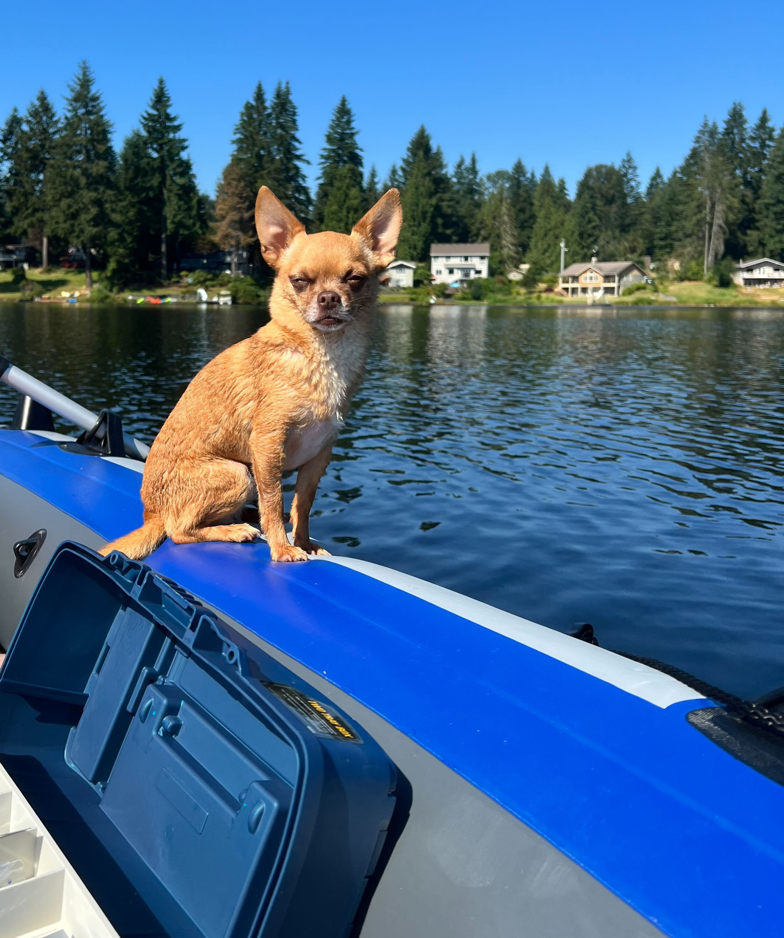
Who is this?
Proud Pet Parent!!! -->Rocky
SIEM-As-A-Service
Vulnerability-As-A-Service
Admin at Nintendo for 10 years
Pentest, Forensics, Incident Response
https://www.linkedin.com/in/jessefmoore/

Slide 4
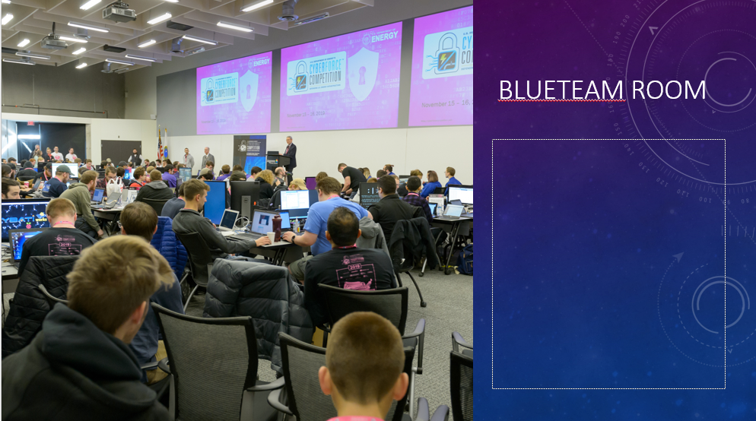
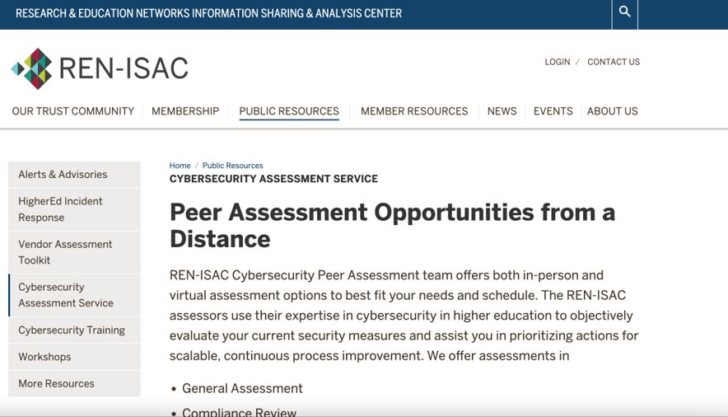
What has Jesse Been up to?
I’ve been working on building CyberForce
https://tinyurl.com/cybforce
REN-ISAC Pentester
CISO workshops:
https://ciso.uw.edu/education/outreach/workshops/#badthings

Slide 5

1. BloodHound 2. PingCastle

Slide 6
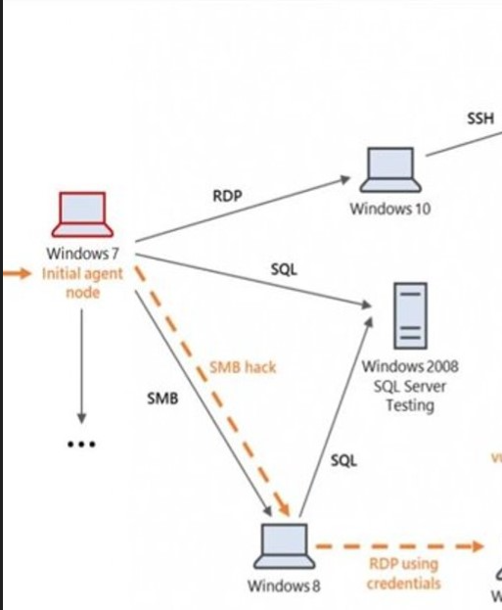
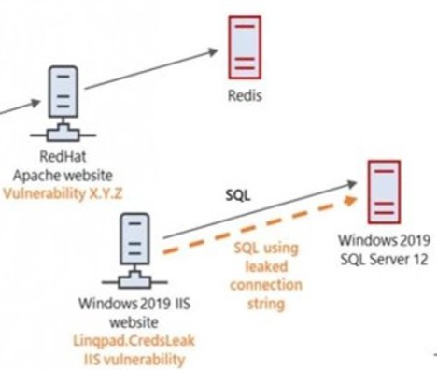
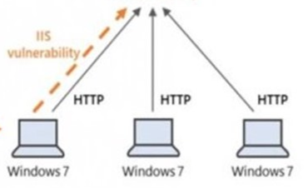
What is a typical scenario?
https://bit.ly/2ZQIfGY
Notes:
Andy At SpecterOps TTPS and Diagram:
https://bit.ly/2ZQIfGY

Slide 7
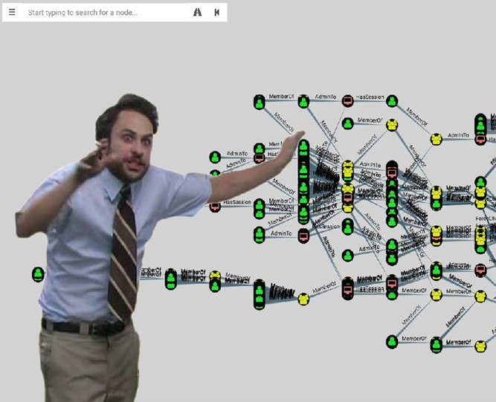
Here is your access to other computers and users
Who has RDP access?
Who can turn off MSFT-Defender?
Who can reset user password?
Who can access PC?
Who can change GPO?

Slide 8
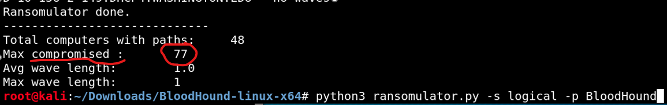
Bloodhound-Answers the question. what systems can get ransomed!
https://tinyurl.com/RansomWS
Notes:
Simulate Ransomware:
sudo git clone https://github.com/zeronetworks/BloodHound-Tools/tree/main/Ransomulator sudo apt-update sudo apt-upgrade sudo apt-get install python3-pip sudo apt-cache madison neo4j python3 -m pip install neo4j python3 -m pip install neo4j-driver pip3 install cornershot root@kali:~/Downloads/BloodHound-linux-x64/BloodHound-Tools/ python3 ransomulator.py -p BloodHound

Slide 9
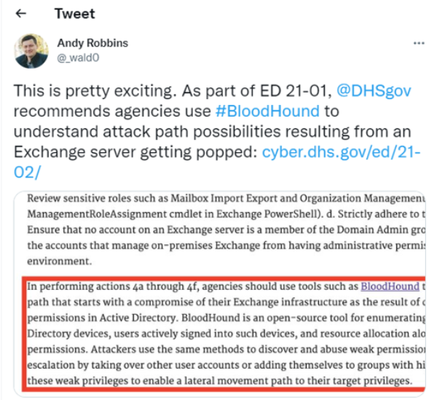
Department of Homeland Security!

Slide 10
BloodHound can be used in many What-If scenarios
1. Add Software (Nessus?) -let’s say an application owner wants to grant application domain service account local admin rights on a set of systems. We’ll measure the potential impact using three step
Step 1: Measure the current risks associated with the service account, the computers in question, and the “DA equivalent” targets in the environment. Step 2: Make the proposed changes in the graph database. Step 3: Re-measure the stats you collected in Step 1.
2. the CEO/Person wants local admin rights on laptop. You want to understand the risks associated with this proposed change.
Step 1: Visualize/measure the possible attack paths originating from the CEO’s/Persons user account and laptop
3. Change Management could use the BloodHound graph to view how much impact to the network for the additional access.
4. Retro-Fit Resilience methodology (remove and constrain/isolate current Users/groups/services/admins accounts permission access in the network to reduce the attack surface.

Slide 11
Continued...
Lots of use cases in BloodHound for defenders:
Monitor derivative admins (how being part of a group gets you local admin on a box that is not inline with your job responsibilities/role)
Quantifying what the software permission has as an impact to network access and permission to computers/users
Measure potential impact of a Phished user (compromise) to business if they can get to sensitive info.

Slide 12
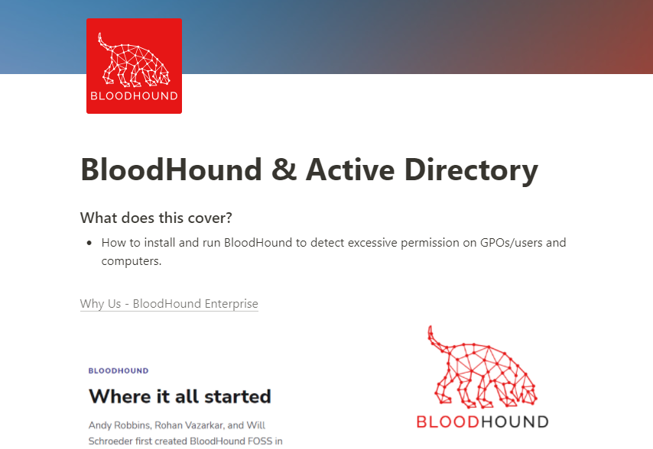
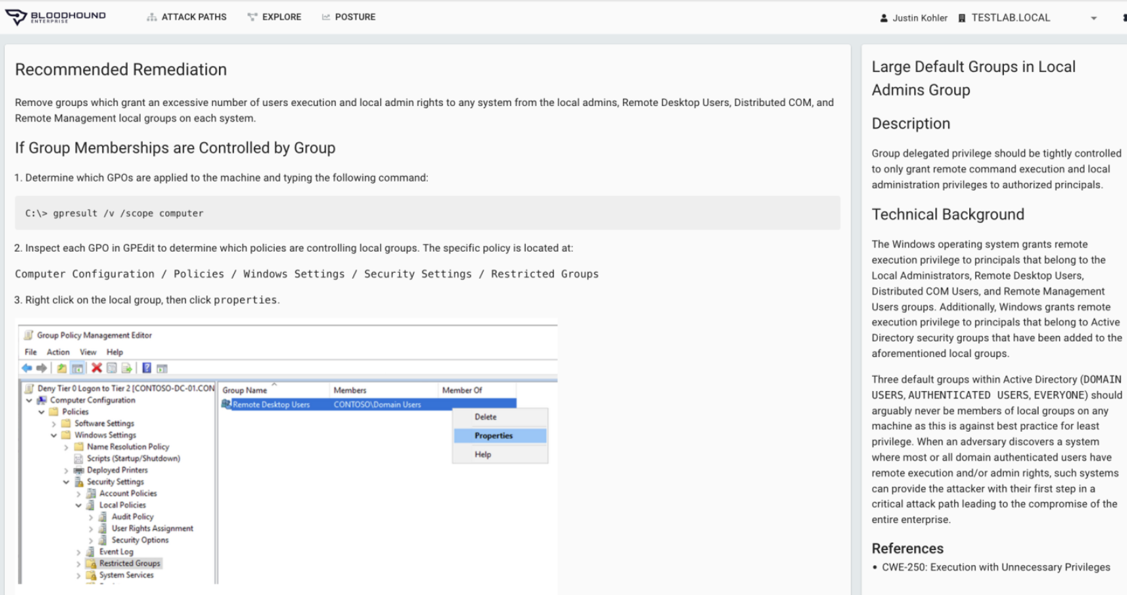
DEMO BloodHound?
AD Assessment
https://tinyurl.com/WSBloodHound
Notes:
# Jesse's Workshop walk through on BloodHound and Ping Castle and Ransomulator
https://grizzly-dibble-cdb.notion.site/BloodHound-Active-Directory-8771c2bd8f11403cbd108b83d97f3053
https://tinyurl.com/WSBloodHound
Introducing BloodHound Enterprise: Attack Path Management for Everyone | by Andy Robbins | Posts By SpecterOps Team Members
BloodHound Enterprise:
https://bloodhoundenterprise.io/our-solution/#real-world-remediation-guidance

Slide 13

Get Active Directory Security at 80% in 20% of the time

Slide 14
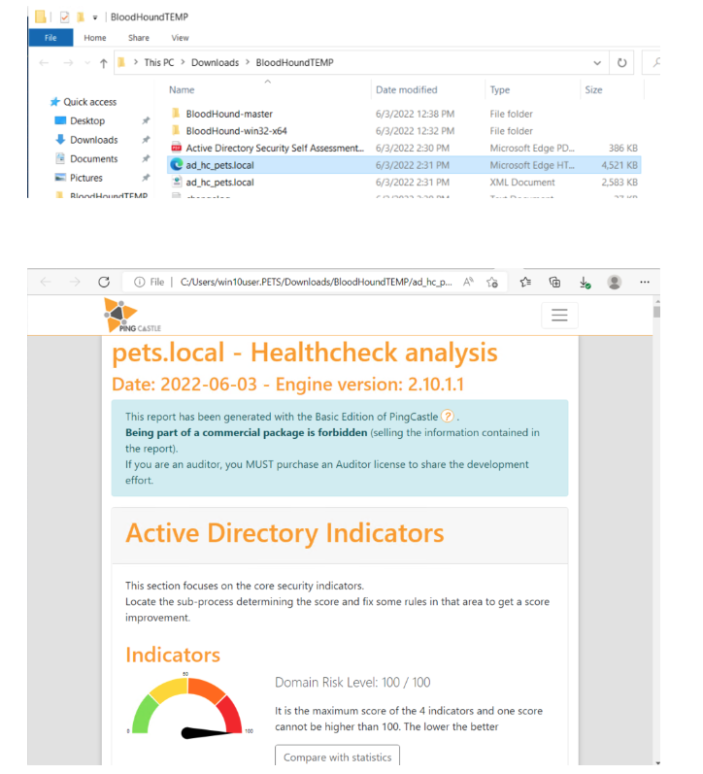
Reports
https://tinyurl.com/PingCastleRules
Notes:
# Jesse's video Walk through on PingCastle
https://screencast-o-matic.com/watch/c31ergV3lgF
PingCastle Health Check rules - 2022-11-06
https://www.pingcastle.com/PingCastleFiles/ad_hc_rules_list.html
https://tinyurl.com/PingCastleRules
Compare it to
file:///C:/Users/jesse/Desktop/pentest_ad_dark.svg
https://orange-cyberdefense.github.io/ocd-mindmaps/img/pentest_ad_dark_2022_11.svg
https://tinyurl.com/ADMindmap

Slide 15
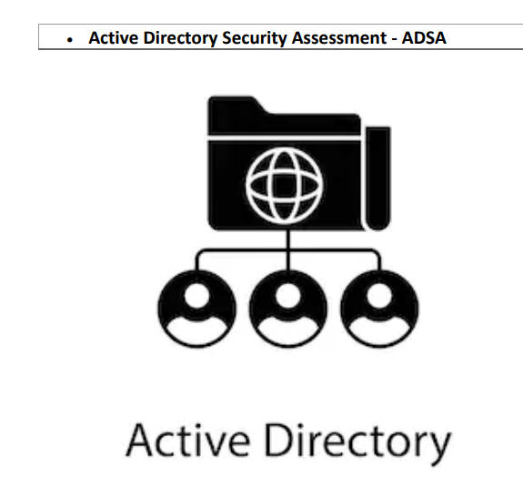
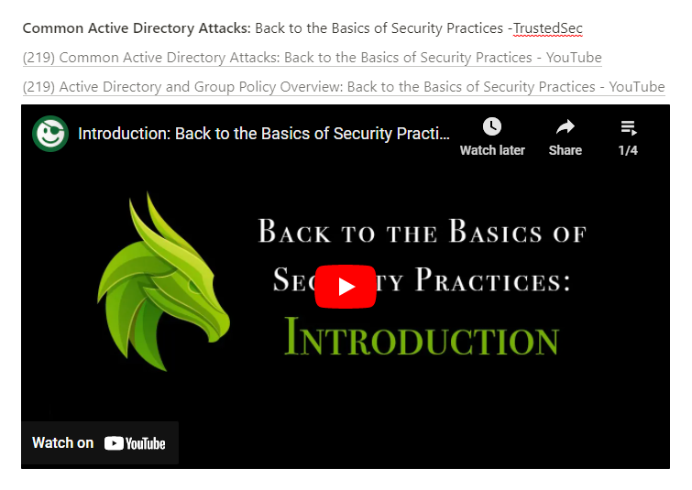
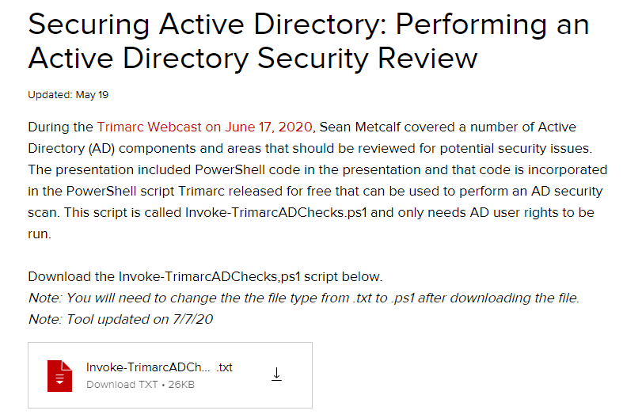
More AD Assessments
https://tinyurl.com/trimarcAD
https://tinyurl.com/ADProTop25
https://tinyurl.com/ADefence
Notes:
MSFT AD Assessment
https://learn.microsoft.com/en-us/services-hub/unified/health/getting-started-adsecurity
Microsoft AD security recommendations
https://learn.microsoft.com/en-us/windows-server/identity/ad-ds/plan/security-best-practices/best-practices-for-securing-active-directory
ADPro
https://tinyurl.com/ADProTop25
https://activedirectorypro.com/active-directory-security-best-practices/
Trimarc
https://www.hub.trimarcsecurity.com/post/securing-active-directory-performing-an-active-directory-security-review
SpecterOps
https://posts.specterops.io/attacking-azure-azure-ad-and-introducing-powerzure-ca70b330511a
Semperis
https://www.semperis.com/solutions/uncover-active-directory-attack-paths/
BlackHIllsInfosec
https://www.blackhillsinfosec.com/tag/active-directory/
PingCastle, PurpleKnight, BloodHound, GoodHound
CISA
https://csrc.nist.gov/projects/ransomware-protection-and-response
Take assessment: https://github.com/cisagov/cset/releases/tag/v10.3.0.0

Slide 16
Take Aways...
Obtain Active Directory Training or Services
Use BloodHound to find how many computers can be infected with ransomware?
Use PingCastle to find what hackers find before the hackers and fix them!
Jesse’s How to/Workshop on BloodHound→ https://tinyurl.com/WSBloodHound
Notes:
Jesse’s Workshop doc:
https://grizzly-dibble-cdb.notion.site/BloodHound-Active-Directory-8771c2bd8f11403cbd108b83d97f3053
https://tinyurl.com/WSBloodHound
https://tinyurl.com/RansomWS
MSFT AD Assessment
https://learn.microsoft.com/en-us/services-hub/unified/health/getting-started-adsecurity
Trimarc
https://www.hub.trimarcsecurity.com/post/securing-active-directory-performing-an-active-directory-security-review
SpecterOps
https://posts.specterops.io/attacking-azure-azure-ad-and-introducing-powerzure-ca70b330511a
https://bit.ly/2ZQIfGY
Semperis
https://www.semperis.com/solutions/uncover-active-directory-attack-paths/
BlackHIllsInfosec
https://www.blackhillsinfosec.com/tag/active-directory/
PingCastle, PurpleKnight, BloodHound, GoodHound
CISA
https://csrc.nist.gov/projects/ransomware-protection-and-response
Take assessment: https://github.com/cisagov/cset/releases/tag/v10.3.0.0

Slide 17


Questions?
Is this FREE?

